Slide 1


Team name: Farmhand
Team members:
1.Faiyaz Shahrear
2.Sabbir Hossain Borno
3.Ashikur Rahman
Pitch ON
‘The Farmhand’

Slide 2

Introduction
Project Name:
The Farmhand
Challenge Name:
Farming Challenge
Idea:
Farmers aren't getting paid a fair price for their goods. There are a lot of miscalculations going on with the manual system. So, to save the farmers we are interesting to make a online platform to ensure farmers their fair wages.
Tagline:
Break the syndicates to save farmer
Mission:
To be an everyday helping hand for farmers and consumers
Vision:
To establish an easy platform between farmers and consumer
Our Logo

Slide 3
Why we choose this…
Farmers are not getting their real value for their product
Products price are going upwards day by day
People are getting more centralized and tended to leave villages
Farmers are burning their crops for not getting their actual value
Previous data says we may have to depend on foreign countries for these products

Slide 4
Features
Real time update what farmers are providing and what customers are getting
Full browsable database about the products
a summery after every year to estimate the needs of each products so farmers can grow accordingly
Real time connection between farmers and the product wholesaler to stop the syndicate-abuses
Automatically forwarding requests to the nearby agents
Information/history on the amount of products farmers are growing all around the country
Ensuring farmers getting real value for their products

Slide 5
People working in this system
Agent
Appointed by company
Admin
System Owner
Users
People with trade license

Slide 6
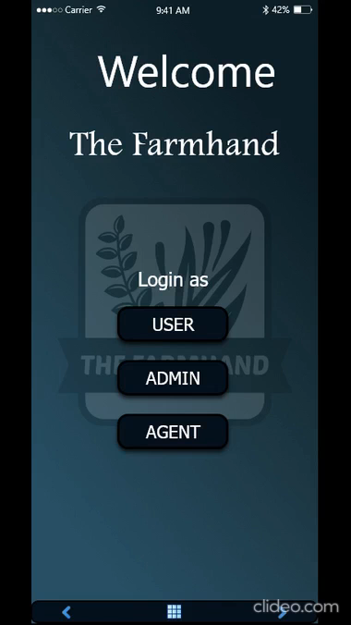
Prototype Video
Here we add a prototype video of our project

Slide 7



How System Works
1. Agent collects data from farmers and input to the system database
2. User requests for a product
3. Admin prepares transport system
4. Request is forwarded to nearby Agents through system
5. Agents allocates the amount he/she can provide and another nearby agent will help if first one can not fulfil the need
6. Agent doesn’t know customer details and customer doesn’t know agent details. All are kept safe in the system
7. System/Admins manages transport services
8. User collects the product

Slide 8
Project Budget
Initial budget
Build online platform (website, app, server) => 20 Lakhs
Warehouse rent => 10 lakhs
Marketing => 10 Lakhs
Others => 10 lakhs

Slide 9
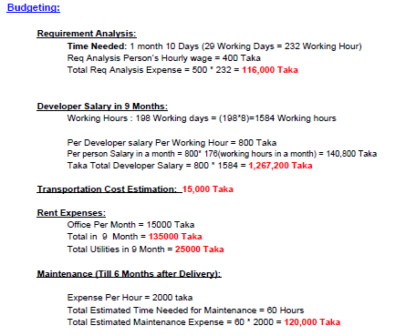
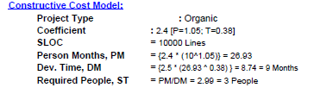
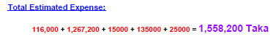

App Budget estimation

Slide 10
Costing for (for i.E.)Rice/kg
Paddy 23tk/kg
1Kg paddy = 0.6 Kg Rice
1Kg Rice = 1.67Kg Paddy
= 38tk/Kg
cost: 40.62tk
Other cost: 1.5 tk
Sale:45 tk
Profit: 2.89 tk per kg
38 taka
0.125 taka
0.769 taka
0.96 taka
0.769 taka

Slide 11
Profit estimation (initial)
Item name | Expected sell per month | Profit
Rice | 200,000 Kg | 578,000 tk
Corn | 30,000 kg | 150,000 tk
Wheat | 40,000 kg | 120,000 tk
Dal | 100,000 kg | 250,000 tk
Total |  | 1098,000 tk

Slide 12
How we promote our system
WORD OF MOUTH
EVENT SPONSORSHIP
BRAND ACTIVISION
CONTENT MARKETING
VISUAL BRANDING
AUDIO BRANDING
VIDEO BRANDING
ONLINE REPRESENTATION

Slide 13
Fundraising
Crowdfunding
Seek venture capital
Raise money through bank loan
Government programs that offer startup capital
Source fund by winning contest

Slide 14
Future planning
Provide loan to the farmers
Add all grocery items gradually
Provide service to entire country
Export product to foreign countries if the project goes that far

Slide 15
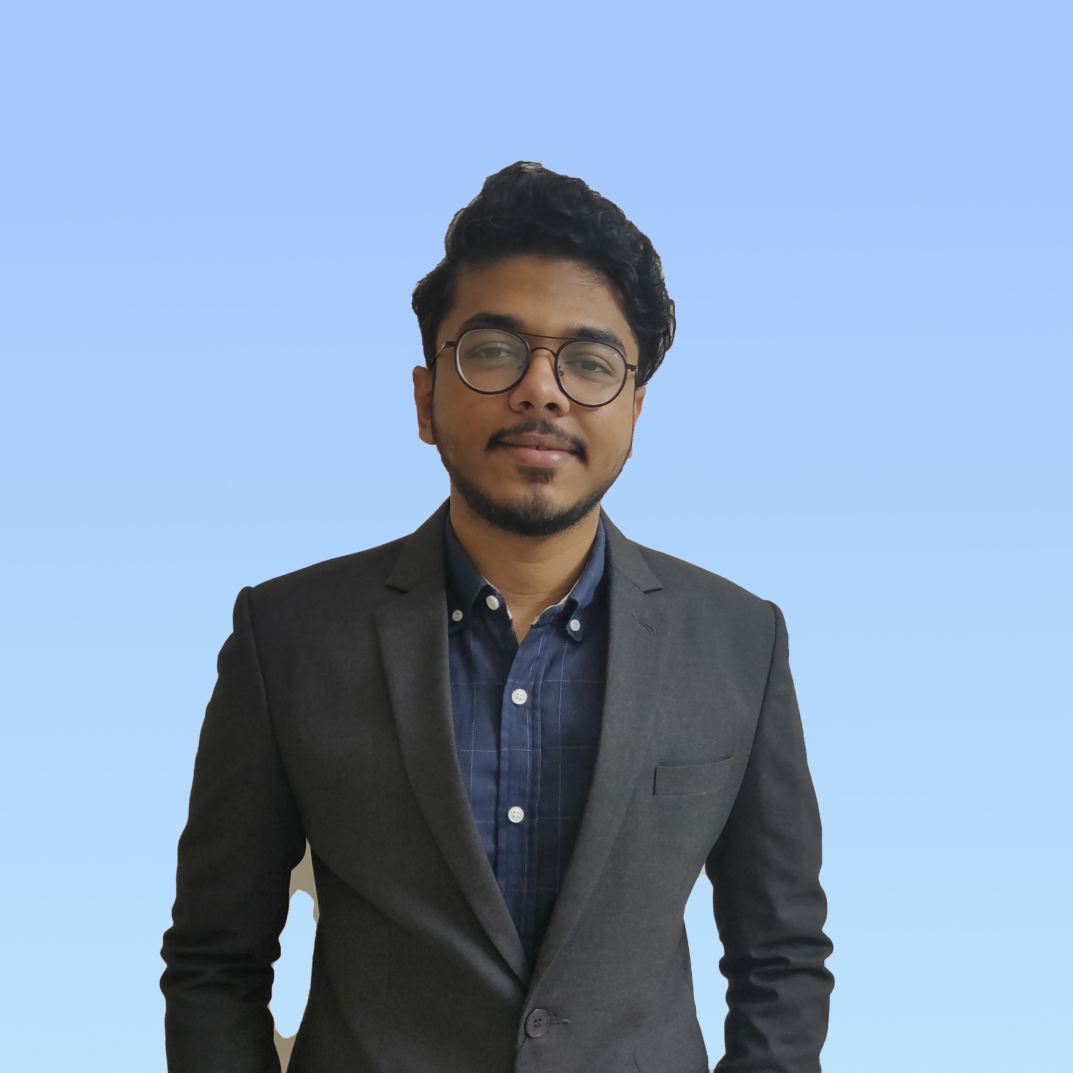
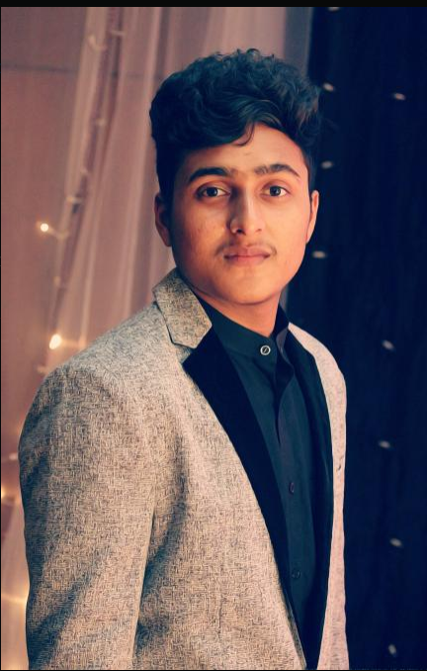
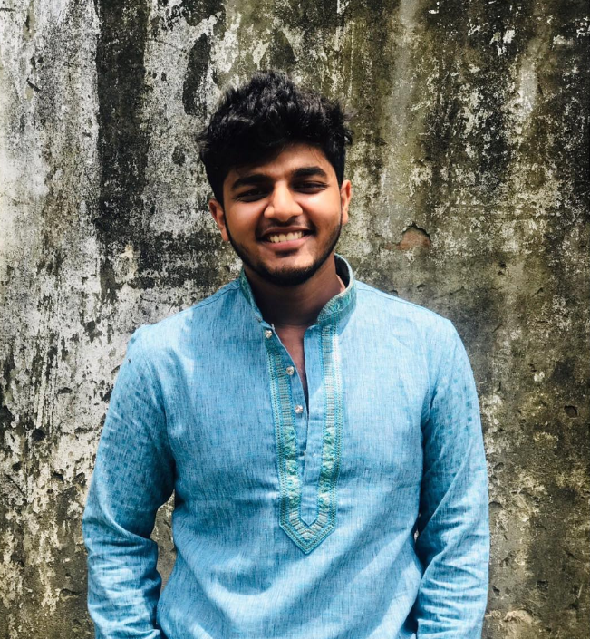
Meet Our Team
Faiyaz Shahrear
BSc Student
Department of Computer Science, AIUB
Team leader, The Farmhand
Linkedin Profile:
https://www.linkedin.com/in/faiyaz-shahrear-b70553154/
Sabbir Hossain Borno
Ashik Rahman
BSc Student
Department of Computer Science, AIUB
Co-leader, The Farmhand
Linkedin Profile:
https://www.linkedin.com/in/sabbir-hossain-borno-a74bb8168/
BSc Student
Department of Computer Science, AIUB
Co-leader, The Farmhand
Linkedin Profile:
https://www.linkedin.com/in/ashik-rahman-864408165/

Slide 16
CONCLUSION
Technologies are blessing to us. By working on this project we have learned so many things that’ll help us to do more projects like this. Eventually we talked with the farmers personally to know every details. Our mission with this project is to provide our services to whole Bangladesh . We hope that if it works according to our mission, one day it will be able to balance the social inequality. We can solve unemployment problem by adding employment on this project. We believe “coming together is a beginning. Keeping together is progress. Working together is success.”

Slide 17
Slide 11
THANK YOU

